Slide 1
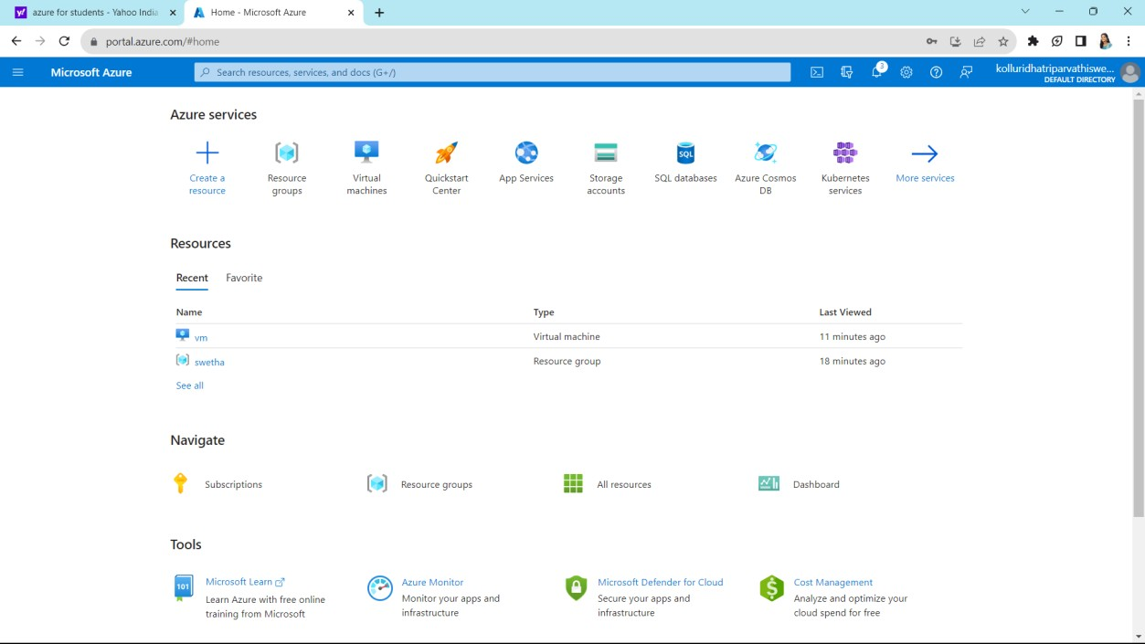
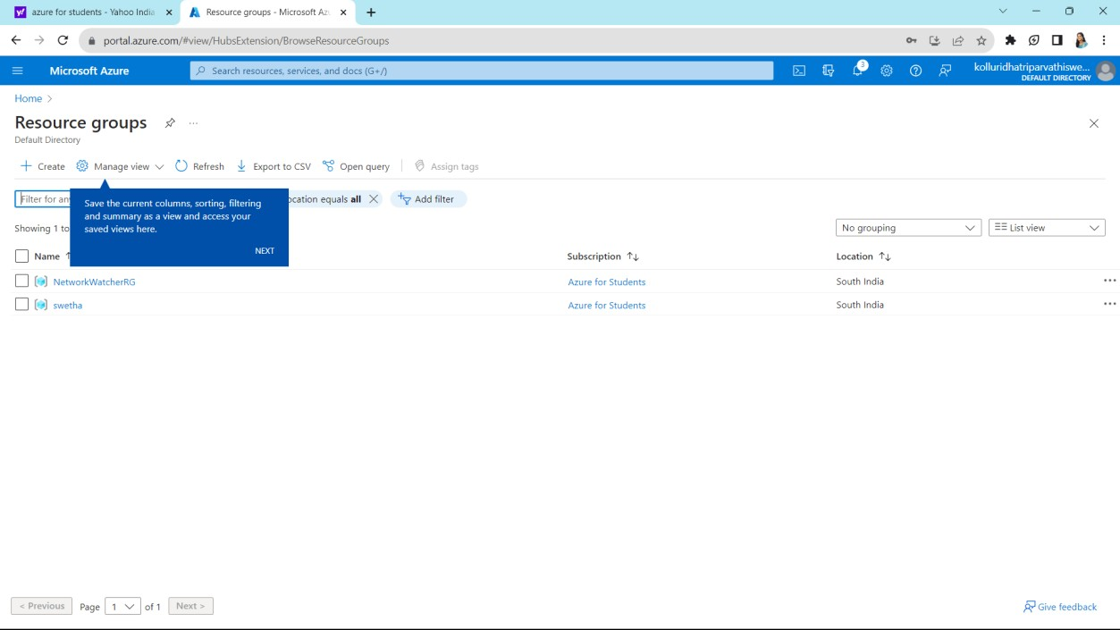
EXPERIMENT 11
Demonstrate Infrastructure as a Service (IaaS) by creating a resources group using a Public Cloud Service Provider (Azure), configure with minimum CPU, RAM, and Storage
first we can sign in into Azure
home page will appears like this now click on resource group
Now click on create which is on left side top

Slide 2
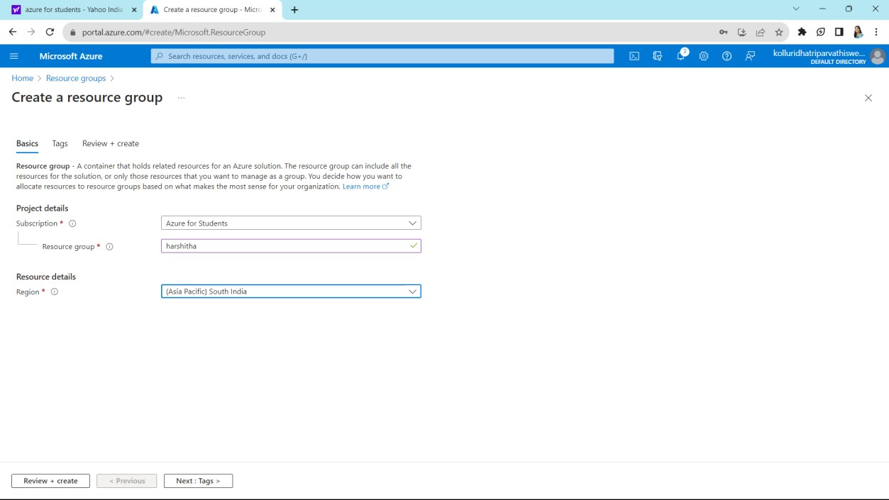
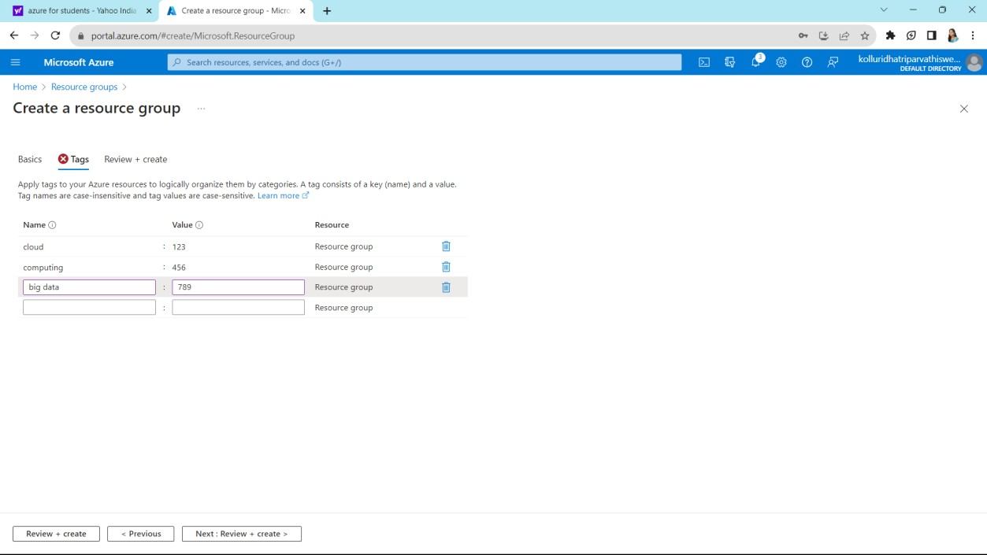
Fill up the required columns and click on next which is on bottum
Give some names and values and the click on next

Slide 3
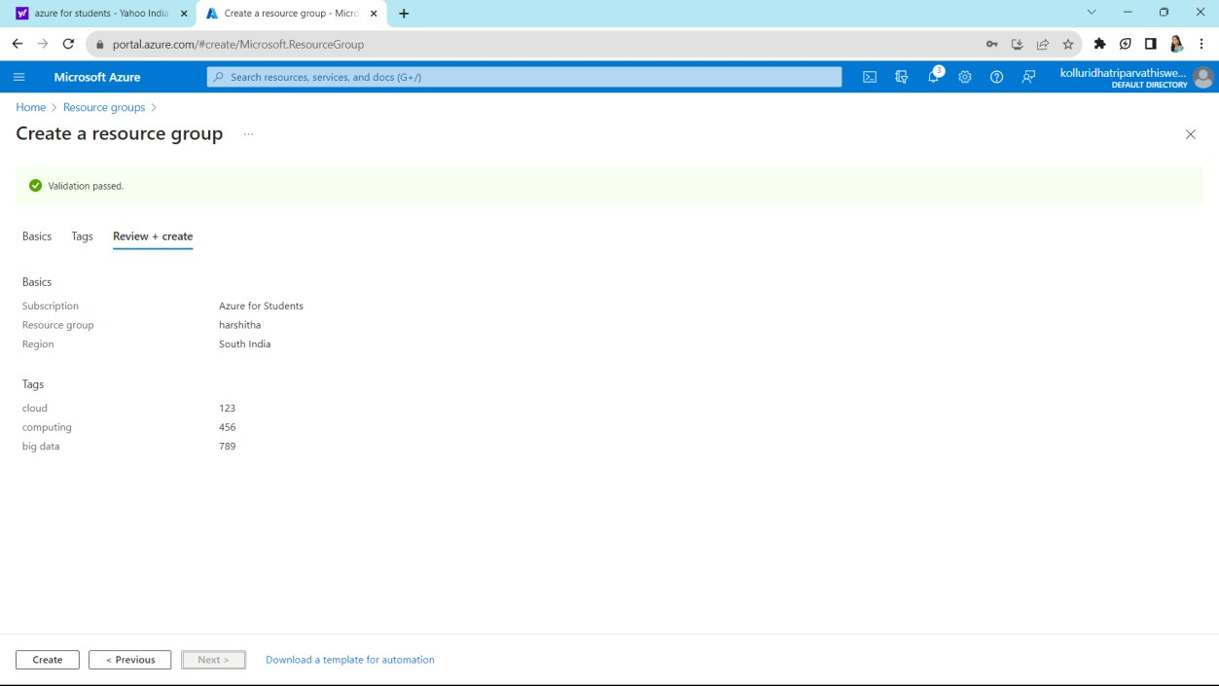
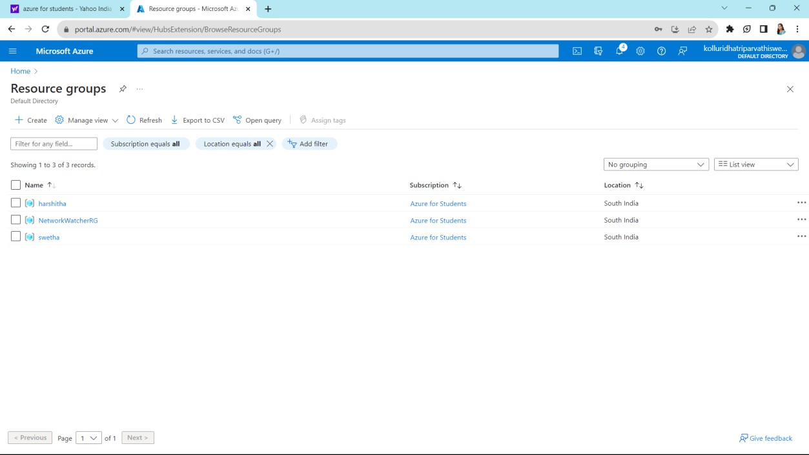
It shows your summary which filled in previous steps verify that and click on create which is on left side bottum
Our required resource group was created and listed below

